Slide 1
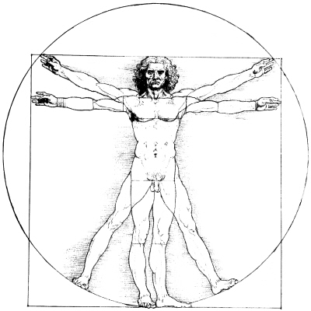
The Cosmic Egg and Vitruvian Man.

